Slide 1
Singapore Neighborhoods
Finding best location to live in for working parents with young children

Slide 2
Singapore Household Characteristics
Majority of Singapore households have > 1 person working
While majority of households have 1 or more children, inferring from the average household size

Slide 3
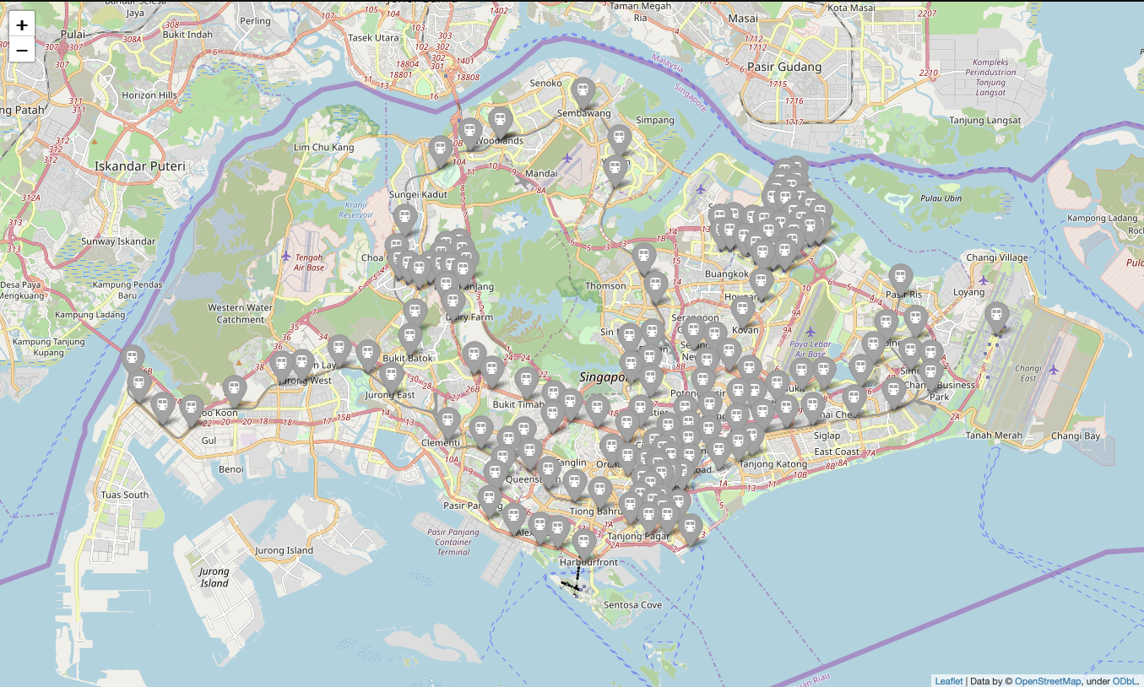
MRT Stations Serves As A Hub For Neighborhoods
Singapore have very efficient public transports
But car prices are extremely high, as much as 6-7x higher compared to the USA
Majority of population rely on MRT and Busses for daily commute
Living nearby MRT stations is the most convenient option
First let’s plot all MRT stations to see all our option

Slide 4
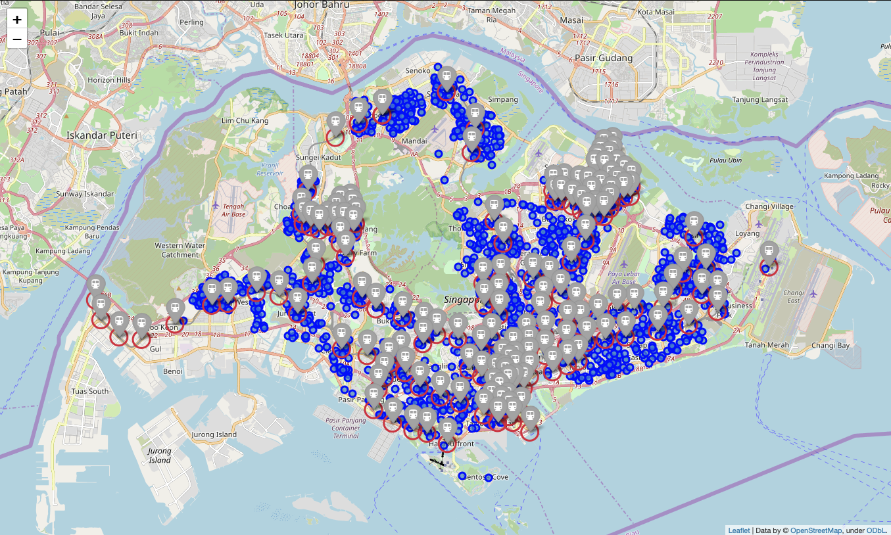
Where Are The Childcare Services?
Working parents with young children often rely on childcare services on weekdays
But finding information of nearby centers is not easy
Let’s plot all available centers next to see its location.
Let’s also plot radius circle to see which one are convenient located near MRT stations

Slide 5
Which MRT Have The Most Number Of Centers Nearby
The MRT stations in green have > 9 stations within 500m radius
I calculate the distance between all MRT stations to all childcare centers
On average there are 6 centers within 500m radius from an MRT station
Because slots are often hard to get, we filter for MRT stations with at least 9 childcare centers nearby (top quartile) to maximize our chance

Slide 6
Filtering For The Best Location
We are still left with 23 locations to choose from after filtering for childcare centers
To narrow our option further I filter for locations with available important amenities nearby using Foursquare Explorer
Then I cluster the neighborhoods using Kmeans clustering to find out neighborhoods with similar characteristics

Slide 7
Our Final Set Of Neighborhood
We have arrived at our final set of neighborhoods that meet most of our criteria (marked in red)
Further analysis shows that there 4 MRT stations that meet all our criteria.
Hopefully this makes our decision making easier!

